Slide 1

Goal: Organize the explanations/statements in front of you
Note: Not all of these statements are true or agreed upon by all scientists. Nonetheless - try to categorize them in a way that they are similar
Rules:
You must make at least 2 categories.
Each category must have at least 2 cards.
Each card should be placed in just one category.
Try to come up with multiple ways to organize the cards and write names for your categories on a piece of paper and what letters fall under each category
Notes:
Start the class by having students do card sort activity.

Slide 2

Please put the cards back in the envelope (for now)
We will come back to these soon!

Slide 3
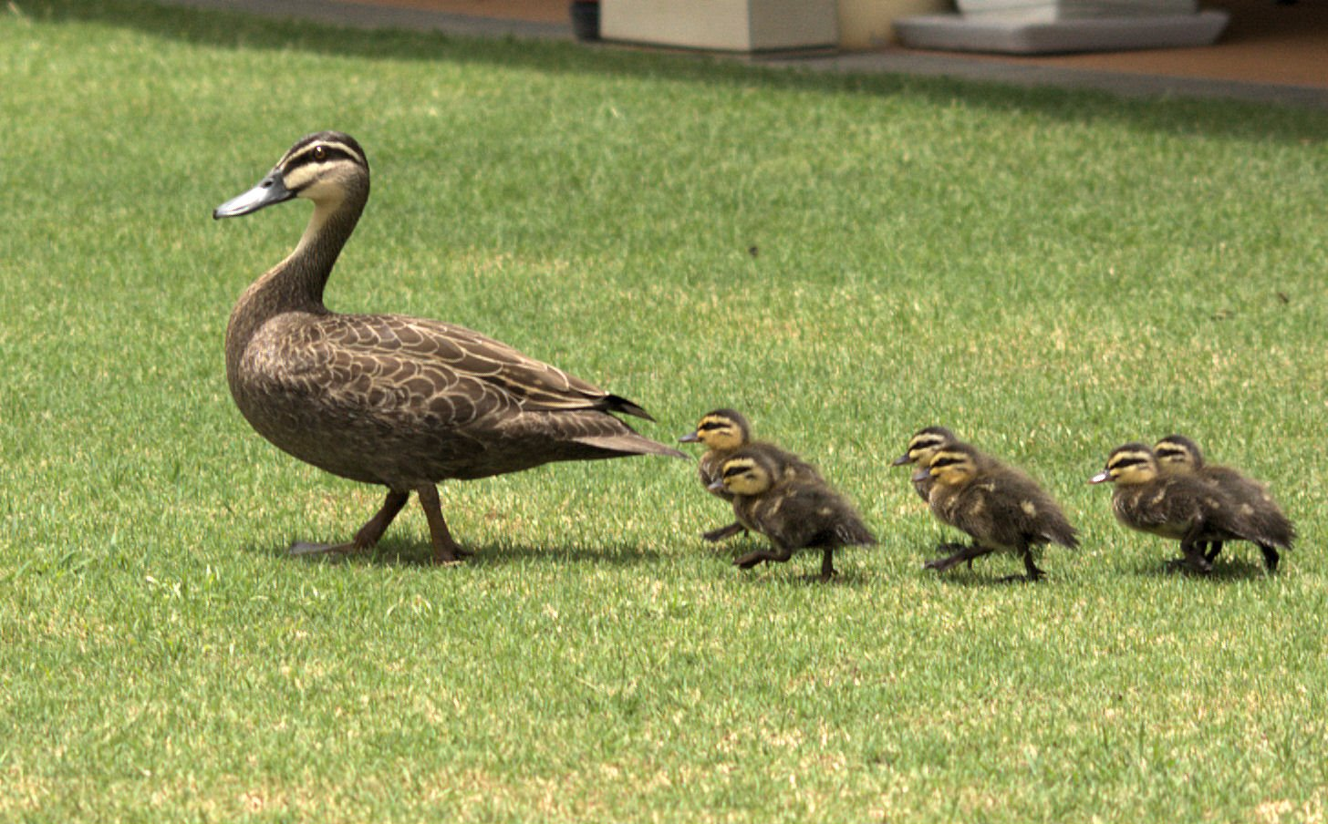
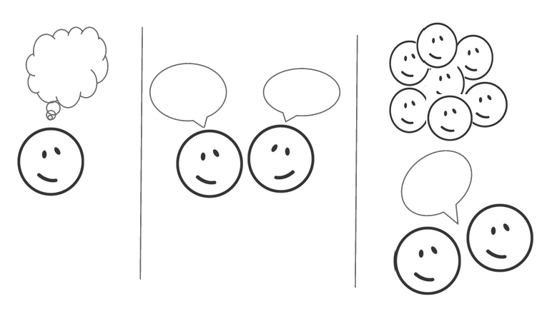
What is happening in this picture?
Why?
30 seconds
1 minute
Notes:
Give students 30 seconds to think about this question to themselves, then have them discuss their thoughts with neighbors for up to one minute, then hear out from groups (Think-Pair-Share).
Let students come up with as many answers to why as possible. Hopefully, some students will provide proximate answers, and some will provide ultimate answers.

Slide 4
…because seeing their mother makes their neurons fire in a way that causes them to follow her.
…because they undergo imprinting upon being born, which is a process that establishes a biological bond to the first object they see.
…because their ancestors underwent imprinting, and they inherited this trait.
…because baby ducks that were able to imprint on their mother were more likely to survive to adulthood than baby ducks who were unable to undergo imprinting.
Proximate explanations
Ultimate explanations
Notes:
Recap with possible explanations to why baby ducks follow their mother duck. Explain that some explanations are more proximate in nature, while others are more ultimate. For advanced students, one may choose to break these out further according to Tinbergen’s Four questions/explanations (Proximate – mechanistic. Proximate – ontogeny/developmental. Ultimate – Function/adaptation. Ultimate- Phylogeny).

Slide 5
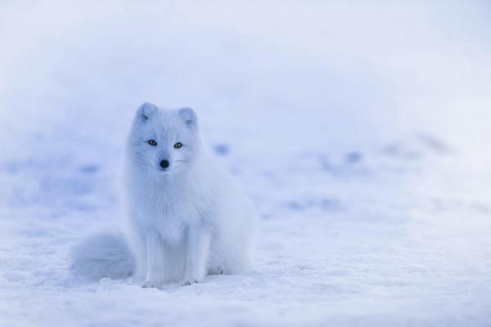
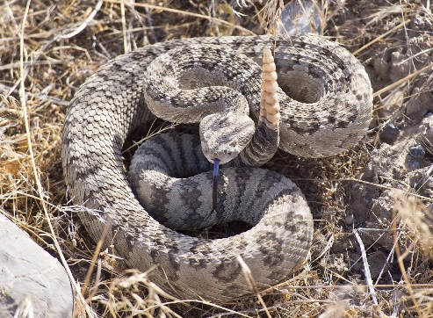
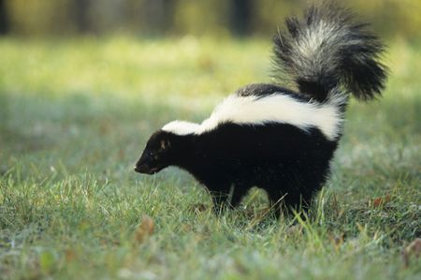
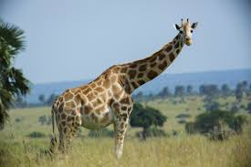
Proximate vs. Ultimate explanations in biology
Proximate: what is the mechanism?
Ultimate: what is the evolutionary reason?
Adaptive traits are somewhat straight forward
Notes:
Further explanation of what a proximate vs. ultimate explanation refers to.

Slide 6
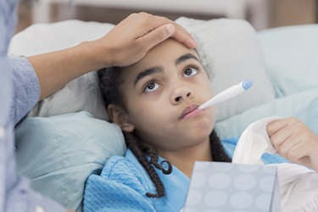
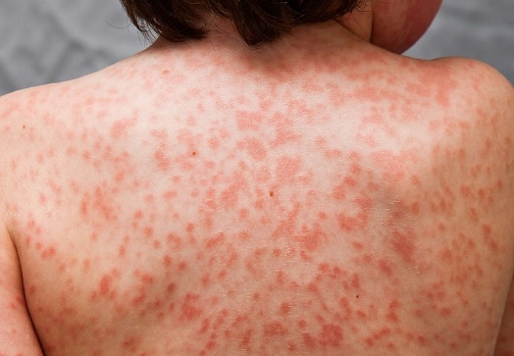
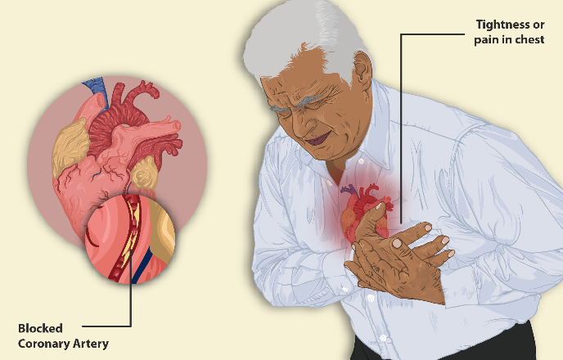
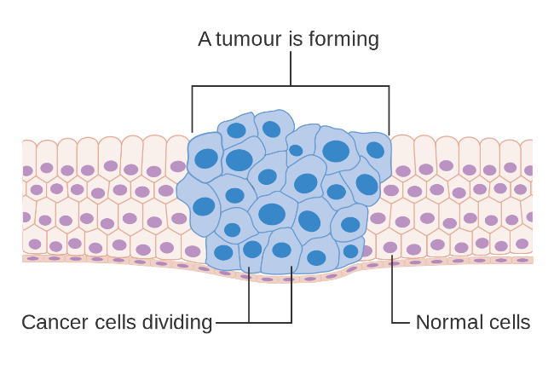
But…
Why do we get sick?
Notes:
Pose the ultimate/evolutionary questions – why do we get sick? Answering this question is the focus of this lesson.
This can be a rhetorical question with the aim to point out how we often focus on adaptations and natural selection, but disease persists. Most medical research focuses on proximate questions – but we can also approach these from an evolutionary point of view.

Slide 7
Evolutionary medicine
Seeks ultimate explanations for disease and disease risks.
Six main ultimate explanations in EvMed.
Goals today:
  Become familiar with the six ultimate explanations for why we are vulnerable to getting sick.
Notes:
Provide a brief introduction to “Evolutionary Medicine” as an interdisciplinary approach that is interested in ultimate explanations for disease.
Provide learning goals for the lesson. This lesson aims to introduce the six ultimate explanations for why we are vulnerable to disease. However, as a single day activity, it is unable to go too deep, so be sure to manage expectations and stay on track to use this as a broad overview lesson.

Slide 8
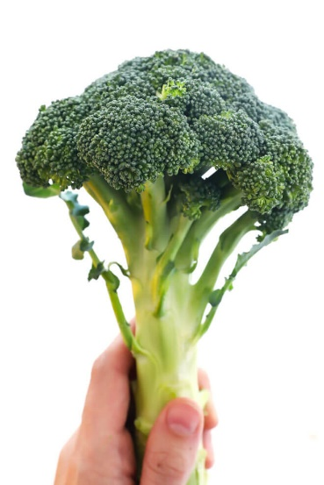
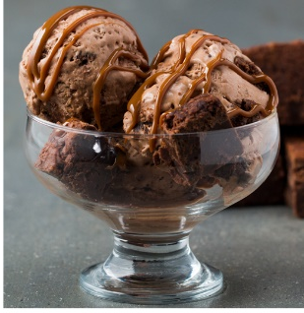
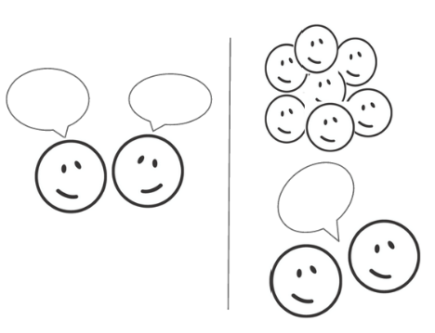
We tend to crave foods that are high in fat, salt, and sugar – usually more than we crave foods that are healthier.
Why might this be? Provide an ultimate hypothesis.
30 seconds
Notes:
Have students generate ultimate hypotheses for why we seem to prefer unhealthy foods that are salty/sugary/fatty. Have them discuss it with their neighbors.

Slide 9
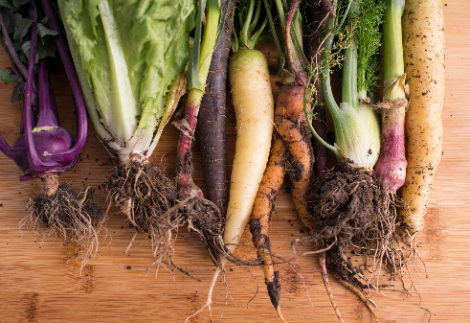
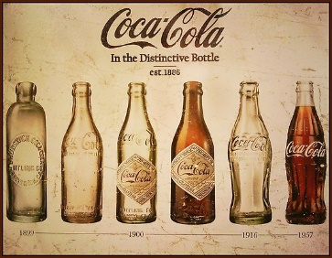
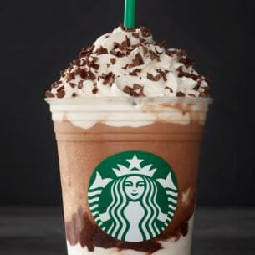
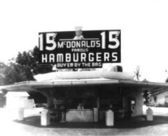
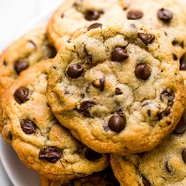

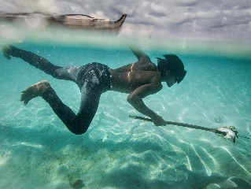
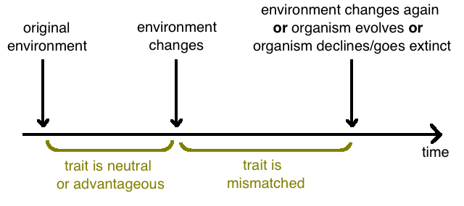
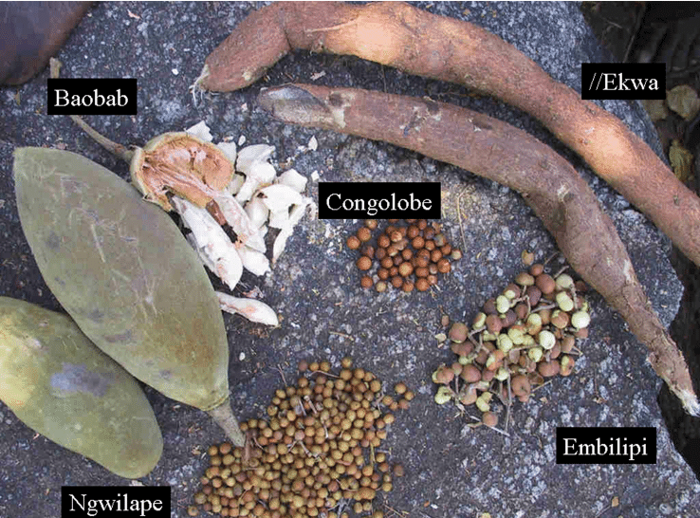
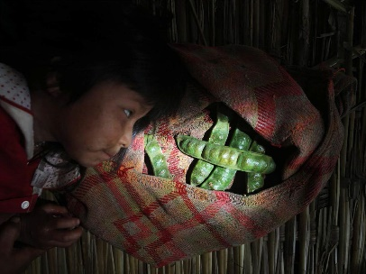
Evolutionary Mismatch
or results in mismatch related health problems
Craving salt, fat, and sugar is no longer as helpful in westernized environments
Craving salt, fat, and sugar is advantageous
https://www.nationalgeographic.com/foodfeatures/evolution-of-diet/
Notes:
Walk through the idea of evolutionary mismatch as it pertains to food availability. Most of human evolution occurred in environments where high calorie meals were not readily available and foods that were calorie rich were something to take advantage of. The transition to a cultural environment where foods high in salt, fat, and sugar became readily available has been very recent, and the production of these foods essentially “hijacks” evolved preferences for these foods.

Slide 10
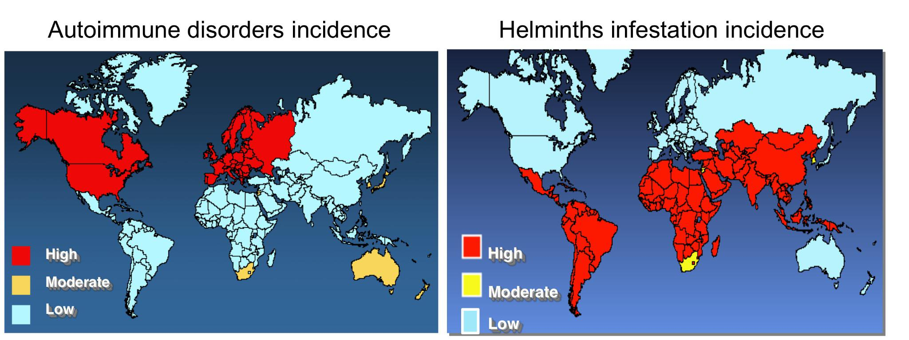
Evolutionary explanations for vulnerability: Mismatch
Traits that evolved in a previous environment may lead to dysfunction after rapid environmental changes
Environmental/lifestyle changes associated with mismatch often come with an overall increase in quality of life
Strosberg, S. A. (2014). The Human-Hookworm Assemblage: Contingency and the Practice of Helminthic Therapy.
Notes:
Often times, mismatch diseases emerge from lifestyle changes that we view as beneficial. For example, medical advances eliminated helminth (parasitic worm) across many populations. However, it appears that the disappearance of helminth infections has altered immune function in a way that has led to an increase in infections.
It is important to note that the evidence presented by these maps is only correlational.

Slide 11
Evolutionary explanations for why we are vulnerable to disease
Mismatch:
  Traits that evolved in a previous environment may lead to dysfunction after rapid environmental changes

Slide 12
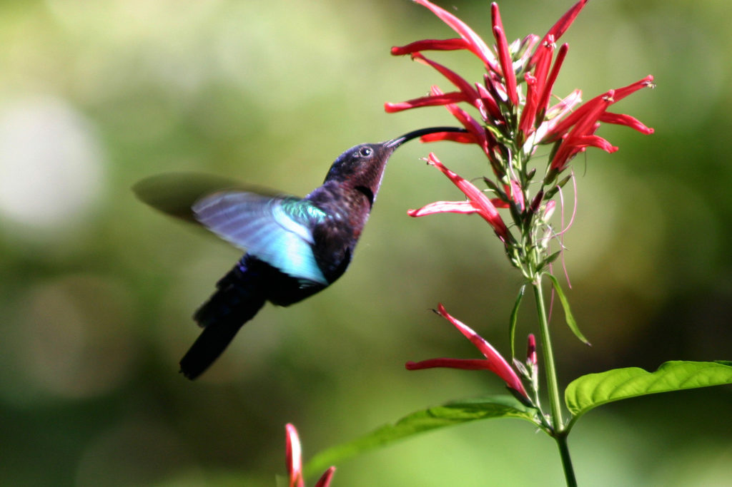
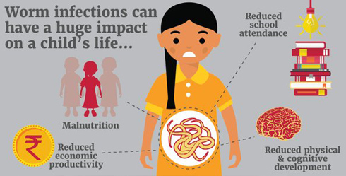
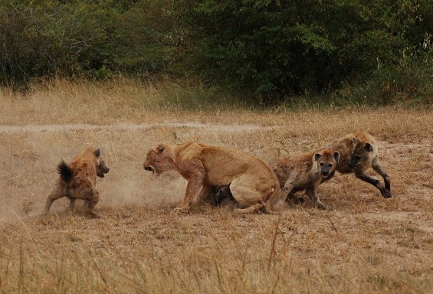
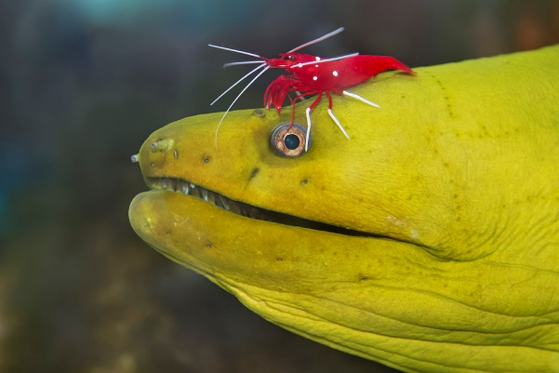
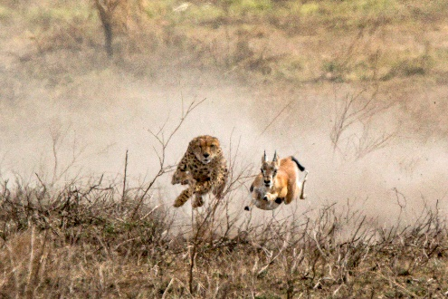
Coevolution
When two (or more) species affect the evolution of one another
  Requires geographical overlap between two species
  Requires ecological interactions between two species
Interactions can be…
  Mutually beneficial
  Parasitic/Predative
  Competitive

Slide 13
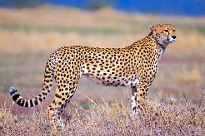
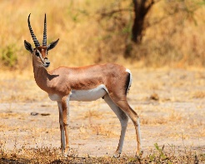

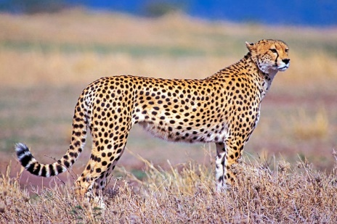
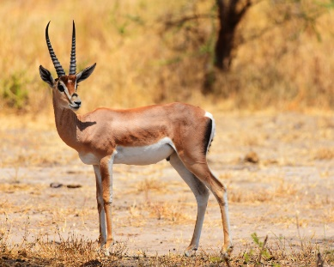
Timepoint 1
What should we expect to happen to the average speed of the population of Gazelles?
Why?
23 mph
20 mph
29 mph
They should get faster – faster gazelles are better at not being eaten by cheetahs – and will thus reproduce more and pass on any genes that lead to increased speed!
25 mph
27 mph
21 mph
22 mph
26 mph
50,000 years later
30 seconds
1 minute
? mph
? mph
? mph
? mph
? mph
? mph
? mph
? mph
Notes:
Have students consider a toy example of an arms-race between Gazelles and Cheetahs.

Slide 14
Timepoint 1
What should we expect to happen to the average speed of the population of Cheetahs?
Why?
23 mph
20 mph
29 mph
They should get faster – faster cheetahs are better at catching gazelles – and will thus reproduce more and pass on any genes that lead to increased speed!
25 mph
27 mph
21 mph
22 mph
26 mph
50,000 years later
30 seconds
1 minute
? mph
? mph
? mph
? mph
? mph
? mph
? mph
? mph
Notes:
Have students consider a toy example of an arms-race between Gazelles and Cheetahs.

Slide 15
Coevolve to get faster and faster…

Slide 16



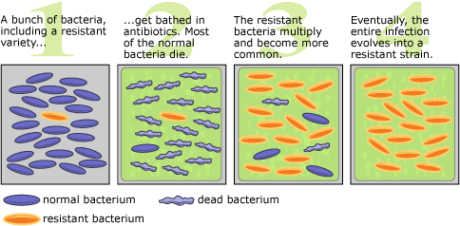
Coevolutionary arms races like this take place with infectious pathogens - too!
Humans and pathogens are constantly co-evolving with each other
  Viruses, bacteria, parasitic worms are all evolving populations
  If humans evolve a novel immune defense…it is likely a matter of time before pathogens evolve their way around that defense
This also renders a lot of our drugs against pathogens ineffective!
Notes:
Explain how infectious pathogens also evolve.

Slide 17
Evolutionary explanations for vulnerability: Coevolution
Pathogens will continually evolve and adapt to evolved defenses in host species
  And are also likely to adapt to any medical advances we can throw their way

Slide 18
Evolutionary explanations for why we are vulnerable to disease
Mismatch:
  Traits that evolved in a previous environment may lead to dysfunction after rapid environmental changes
Coevolution:
  Pathogens will continually evolve and adapt to evolved defenses in host species

Slide 19


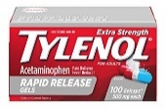

In an intensive Care Unit, patients were randomly assigned to one of two groups:
Aggressive group
Permissive group
Acetaminophen every 6 hours for temperature over 38.5°C (101.3°F).
Cooling blanket for temperature over 39.5°C (103.1°F).
Acetaminophen and cooling blanket only for temperature > 40°C (104°F).
44 patients
38 patients
The researchers measured the number of patients that experienced secondary infections and how many patients died while in the ICU. What do you think they found?
Aggressive group had fewer infections and fewer deaths
Aggressive group had more infections, but fewer deaths
Aggressive group had more infections and more deaths
Aggressive group had fewer infections but more deaths
1 minute
Notes:
Introduce students to a study where intensive care unit patients were randomly assigned to one of two groups. One where Acetaminophen was given every six hours for fevers over 101.3°F (Aggressive group), or one where Acetaminophin was only given if fevers exceeded 104°F, in which case it was given with a cooling blanket.
Have students think about the question silently to themselves, and make a silent guess for what the researchers would find.
Carl I. Schulman, Nicholas Namias, James Doherty, Ronald J. Manning, Pamela Li, Ahmed Elhaddad, David Lasko, Jose Amortegui, Christopher J. Dy, Lucie Dlugasch, Gio Baracco, and Stephen M. Cohn. Surgical Infections.Dec 2005.369-375.http://doi.org/10.1089/sur.2005.6.369

Slide 20
When you have a fever, why might your doctor recommend for you to take tylenol?
If the fever is the result of an infectious disease, then tylenol will help kill the infectious agent, and thus lower the fever.
The tylenol will reduce the fever, which helps kill off the infectious agent.
The tylenol reduces the fever, which makes us feel better.
None of the above
Notes:
Have students keep the previous question in mind, and now have them switch to thinking about this question.

Slide 21
When you have a fever, why might your doctor recommend for you to take tylenol?
If the fever is the result of an infectious disease, then tylenol will help kill the infectious agent, and thus lower the fever.
The tylenol will reduce the fever, which helps kill off the infectious agent.
The tylenol reduces the fever, which makes us feel better.
None of the above

Slide 22
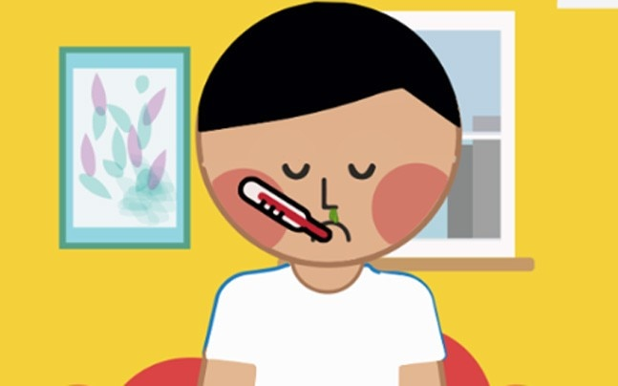

Evolutionary explanations for vulnerability: Evolved defenses
There are things our bodies experience, like pain and fever, that are adaptive mechanisms for fighting off pathogens and other dangers!
  Not necessarily dangerous symptoms of an infection or being hurt
It stinks that they are uncomfortable…
  …but an uncomfortable individual who survives has higher reproductive fitness than someone who is comfortable but dies

Slide 23
In an intensive Care Unit, patients were randomly assigned to one of two groups:
Aggressive group
Permissive group
Acetaminophen every 6 hours for temperature over 38.5°C (101.3°F).
Cooling blanket for temperature over 39.5°C (103.1°F).
Acetaminophen and cooling blanket only for temperature > 40°C (104°F).
44 patients
38 patients
The researchers measured the number of patients that experienced secondary infections and how many patients died while in the ICU. What do you think they found?
Aggressive group had fewer infections and fewer deaths
Aggressive group had more infections, but fewer deaths
Aggressive group had more infections and more deaths
Aggressive group had fewer infections but more deaths
Notes:
Return to the original study slide. Have students discuss their original answers that they answered to themselves. Ask students to discuss with their neighbors whether they have changed their responses or not, and why.
Go over answer with students.
Carl I. Schulman, Nicholas Namias, James Doherty, Ronald J. Manning, Pamela Li, Ahmed Elhaddad, David Lasko, Jose Amortegui, Christopher J. Dy, Lucie Dlugasch, Gio Baracco, and Stephen M. Cohn. Surgical Infections.Dec 2005.369-375.http://doi.org/10.1089/sur.2005.6.369
Have students think about the question silently to themselves, and make a silent guess for what the researchers would find.
Carl I. Schulman, Nicholas Namias, James Doherty, Ronald J. Manning, Pamela Li, Ahmed Elhaddad, David Lasko, Jose Amortegui, Christopher J. Dy, Lucie Dlugasch, Gio Baracco, and Stephen M. Cohn. Surgical Infections.Dec 2005.369-375.http://doi.org/10.1089/sur.2005.6.369

Slide 24
In an intensive Care Unit, patients were randomly assigned to one of two groups:
Aggressive group
Permissive group
Acetaminophen every 6 hours for temperature over 38.5°C (101.3°F).
Cooling blanket for temperature over 39.5°C (103.1°F).
Acetaminophen and cooling blanket only for temperature > 40°C (104°F).
44 patients
38 patients
131 infections
(4 ± 6 per patient)
85 infections
(3 ± 2 per patient)
7 deaths
1 death
The study was stopped after an interim analysis due to the mortality difference.
Notes:
Results indicated that patients in the permissive group did better overall than those in the aggressive group. It is important to note that this does not mean that we should never reduce fevers.
Carl I. Schulman, Nicholas Namias, James Doherty, Ronald J. Manning, Pamela Li, Ahmed Elhaddad, David Lasko, Jose Amortegui, Christopher J. Dy, Lucie Dlugasch, Gio Baracco, and Stephen M. Cohn. Surgical Infections.Dec 2005.369-375.http://doi.org/10.1089/sur.2005.6.369

Slide 25
Evolutionary explanations for why we are vulnerable to disease
Mismatch:
  Traits that evolved in a previous environment may lead to dysfunction after rapid environmental changes
Coevolution:
  Pathogens will continually evolve and adapt to evolved defenses in host species
Evolved defenses:
  Sometimes, what we think of as being sick is actually our bodies own defense system fighting off a dangerous infectious agent

Slide 26
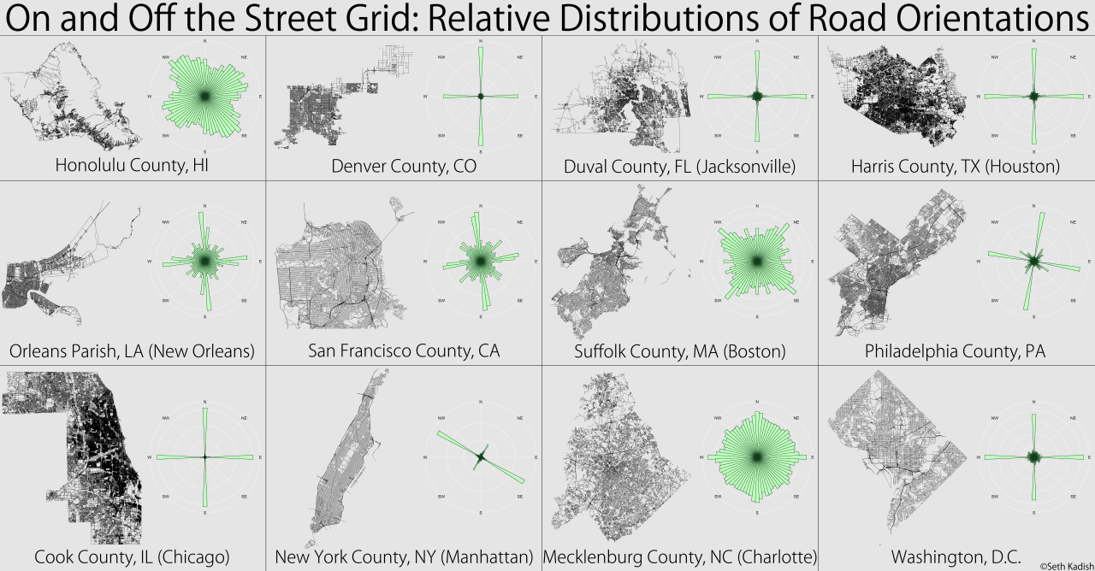
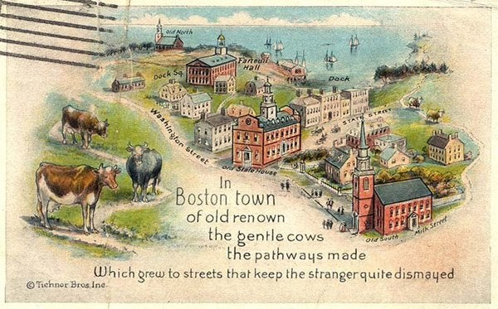
Optimizing urban design
Cities are easier to navigate when roads are set up on a grid system
Some cities use a grid (e.g. Washington DC, Chicago, New York)
Some don’t (e.g. Boston)
https://vizual-statistix.tumblr.com/post/80468941142/unlike-like-emperor-kuzco-i-was-actually-born
Notes:
Introduce evolutionary constraints by discussing street layouts.
Many cities are organized around a grid system, which eases navigation. Boston, MA is notorious for having a road system that is difficult to navigate.
The common explanation given for this is that the roads were paved on top of old cow paths.

Slide 27
Imagine that the local government of Boston decided that they wanted to switch to a grid system.
Do you think this is possible?
Why or why not?
30 seconds
2 minutes
Notes:
Have students consider whether it would be possible for Boston to go from their current road layout to a grid system. Typically, students will realize that it would be too disruptive to completely reroute all of the streets.

Slide 28
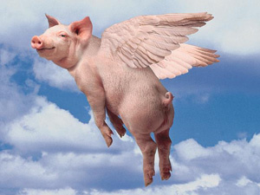
Boston is constrained.
Even if they had the resources to completely rearrange the city…
The city would have to destruct all kinds of building…
The city would become even more inefficient during the reconstruction…
You know what else is constrained?
Evolution.
Notes:
Recap the issue of completely changing Boston’s layout, use as a segue into discussing constraints on Evolution.

Slide 29
We can dream up all kinds adaptive traits and changes that evolution will never land on due to constraints
Evolution can only use what is available
  Evolution is historically contingent
  Variation may not be available to be selected
A new trait may not be developmentally possible
  A change that would result in a new trait may alter development in a way that is detrimental
Physical constraints imposed by forces like gravity
Notes:
Walk through different types of constraints on evolution

Slide 30
Evolutionary explanations for why we are vulnerable to disease
Mismatch:
  Traits that evolved in a previous environment may lead to dysfunction after rapid environmental changes
Coevolution:
  Pathogens that replicate quickly will continually evolve and adapt to any newly evolved defenses in host species
Evolved defenses:
  Sometimes, what we think of as being sick is actually our bodies own defense system fighting off a dangerous infectious agent
Constraints on what natural selection can do
  Natural selection is unable to just make any trait appear because it seems good

Slide 31
I want a car that…
has a high-powered engine with fast acceleration
is gas efficient
is big enough to fit a family of six
Is there anything that comes to mind?
Notes:
Pivot to trade-offs by having students consider whether it is possible to have a car that does it all.

Slide 32



Trade-offs
?
?
Gas
efficiency
Gas
efficiency
Engine power
Car size
Notes:
If the auto-industry could create affordable cars where the question marks are, they certainly would. But engineering is constrained by trade-offs.
Transition to next slide: “You may be wondering why we are talking about cars…
Well, the same general principle applies to phenotypes…”

Slide 33
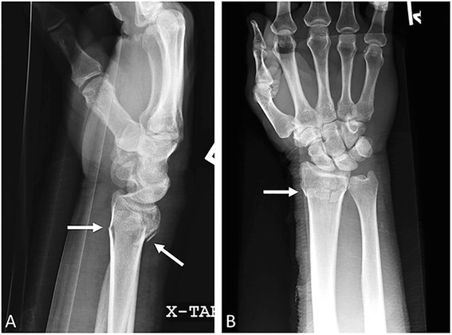
Evolutionary explanations for vulnerability: Trade-offs
Resources (time, energy, materials) are limited
  Resources allocated one way means there are fewer resources to allocate other ways
Changing one trait often requires changes to a second trait
Almost all traits are linked to other traits
Notes:
Can discuss how energy allocation includes trade-offs. Energy invested into energy cannot be invested into reproduction, and vice versa. Early childhood sicknesses that result in energetically costly immune responses can take away from energy that would otherwise go toward development.
Can also discuss colles fractures of the wrist. Thicker bones in the wrist might make it harder to fracture one’s wrist – but it would likely reduce wrist mobility.

Slide 34
Evolutionary explanations for why we are vulnerable to disease
Mismatch:
  Traits that evolved in a previous environment may lead to dysfunction after rapid environmental changes
Coevolution:
  Pathogens will continually evolve and adapt to evolved defenses in host species
Evolved defenses:
  Sometimes, what we think of as being sick is actually our bodies own defense system fighting off a dangerous infectious agent
Constraints on what natural selection can do
  Natural selection is unable to just make any trait appear because it seems good
Trade-offs
  Traits are interrelated, so sometimes improving one trait requires harming another trait

Slide 35
“Fitness” is a term most often used by biologists to explain the evolutionary success of certain organisms. Below is a description of 4 fictional lizards. Which lizard might a biologist consider to be the “most fit”?
Finch ID | Lizard A | Lizard B | Lizard C | Lizard D
Body length | 20 cm | 12 cm | 10 cm | 15 cm
Offspring surviving to adulthood | 19 | 28 | 22 | 26
Age at death | 4 years | 5 years | 4 years | 6 years
Comments | Lizard A is very healthy, strong, and clever | Lizard B has mated with many lizards | Lizard C is dark colored and very quick | Lizard D has the largest territory of all the lizards
Lizard A
Lizard B
Lizard C
Lizard D
Notes:
Have students take time to come up with an answer silently to themselves, then allow time for students to discuss with neighbors.
Question comes from: Anderson, D. L., Fisher, K. M., & Norman, G. J. (2002). Development and evaluation of the conceptual inventory of natural selection. Journal of research in science teaching, 39(10), 952-978.

Slide 36
“Fitness” is a term most often used by biologists to explain the evolutionary success of certain organisms. Below is a description of 4 fictional lizards. Which lizard might a biologist consider to be the “most fit”?
Finch ID | Lizard A | Lizard B | Lizard C | Lizard D
Body length | 20 cm | 12 cm | 10 cm | 15 cm
Offspring surviving to adulthood | 19 | 28 | 22 | 26
Age at death | 4 years | 5 years | 4 years | 6 years
Comments | Lizard A is very healthy, strong, and clever | Lizard B has mated with many lizards | Lizard C is dark colored and very quick | Lizard D has the largest territory of all the lizards
Lizard A
Lizard B
Lizard C
Lizard D
Notes:
The goal of this question is to clarify that the number of surviving offspring is the most important metric for natural selection – not necessarily health, vigor, or strength.

Slide 37
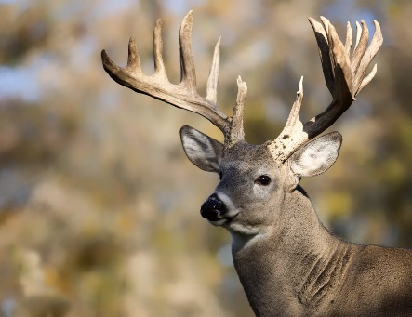
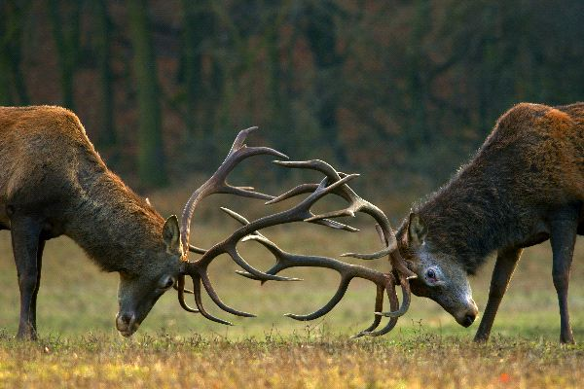
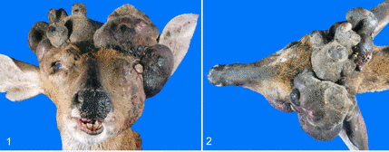
Fitness can sometimes come at the cost of health
Large antlers can help male deer compete for mates, leading to more mating opportunities
However, the ability to quickly grow large antlers increases the risk of cancerous growth (antleroma)
Natural selection will select for traits that increase disease risk so long as those traits result in an overall increase in reproductive fitness
Antleroma – antler cancer
Notes:
Sometimes traits that are selected for that help increase reproductive success come at the expense of greater disease risks.
One example is the increased risk of cancer that comes with selection for the ability to grow large antlers rapidly.

Slide 38
Evolutionary explanations for why we are vulnerable to disease
Mismatch:
  Traits that evolved in a previous environment may lead to dysfunction after rapid environmental changes
Coevolution:
  Pathogens will continually evolve and adapt to evolved defenses in host species
Evolved defenses:
  Sometimes, what we think of as being sick is actually our bodies own defense system fighting off a dangerous infectious agent
Constraints on what natural selection can do
  Natural selection is unable to just make any trait appear because it seems good
Trade-offs
  Traits are interrelated, so sometimes improving one trait requires harming another trait
Reproduction at the cost of health
  Natural selection may result in traits that increase the likelihood of disease – if they result in improved reproductive fitness!

Slide 39
Six evolutionary explanations for vulnerability
Defenses
Coevolution
Mismatch
Reproduction at the
cost of health
Not mutually exclusive
Trade-offs
Constraints
Notes:
Use this slide to explain how these six explanations serve as a useful framework.
Students should know that this lesson was not aimed to make them experts in each of these six principles, but instead to introduce them. Make it clear that these principles underlie a lot of work in a EvMed, and when considering ultimate explanations for disease risks, these will commonly be part of the story.
It should also be made clear to students that these are not mutually exclusive. In fact, understanding most diseases from an evolutionary point of view requires combining two or more of these principles.

Slide 40
Goal: Organize the explanations/statements in front of you
Note: Not all of these statements are true or agreed upon by all scientists. Nonetheless - try to categorize them in a way that they are similar
Rules:
You must make at least 2 categories.
Each category must have at least 2 cards.
Each card should be placed in just one category.
Try to come up with multiple ways to organize the cards and write names for your categories on your worksheet and what letters fall under each category
Notes:
Have students re-open their envelopes, and

Slide 41
Evolved Defenses
C, K, J
Constraints
B, N
Trade-offs
H, L, M
Reproduction more important than health
F, M
Mismatch
A, E, I
Coevolution
D, G, O

Slide 42
Please place the cards neatly back into the envelope – make sure A-O are all in that envelope

